Slide 1
Support Vector Machine (SVM) Explained for beginners
Linear Discriminant.
Feature Spaces and Kernels.
Maximum Margin Discriminant.
SVM vs Logistic Regression.
Hands-on in Python.

Slide 2
Linear Discriminant

Slide 3
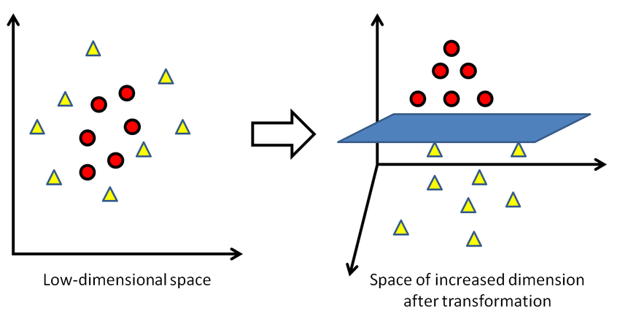
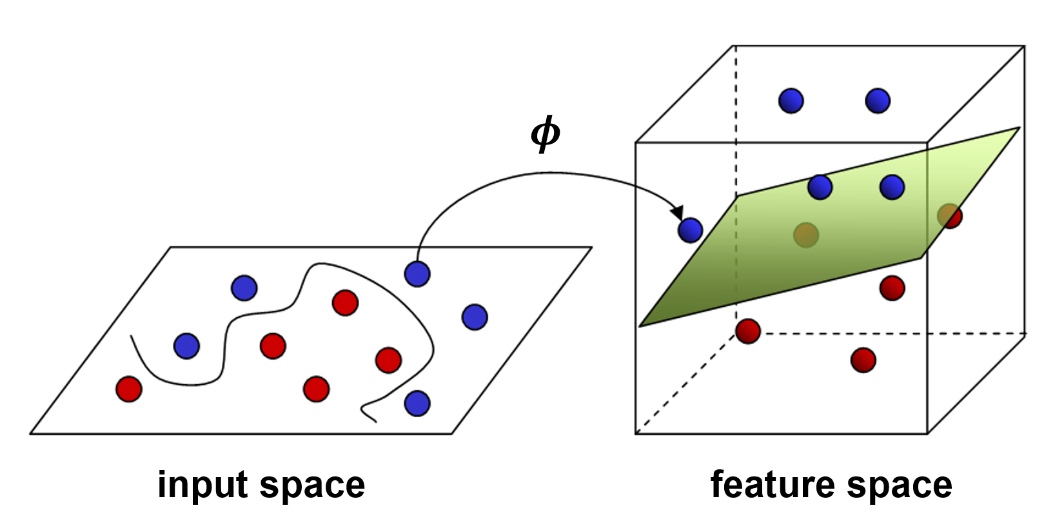
Non-Linear Discriminant

Slide 4
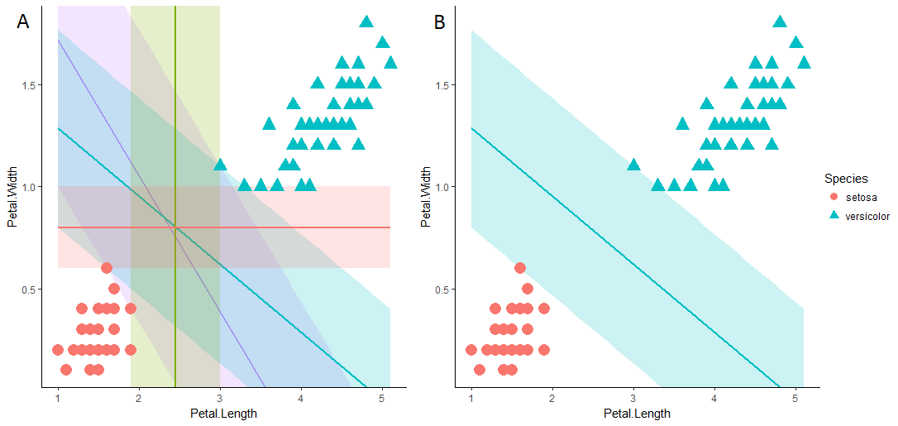
Margins

Slide 5
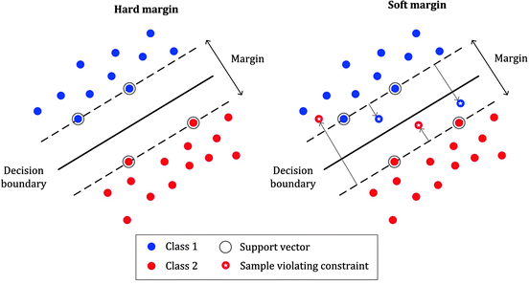
SVM: Hard vs Soft

Slide 6
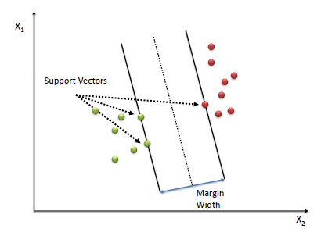
SVM vs Logistic Regression

Slide 7
Website : www.aisciences.io

